Slide 1
Fall 2020
DATS 501 Fundamentals of Data Science
Hasan Demirtaş
hdemirtas.academic@gmail.com

Slide 2
Linear Models

Slide 3
Ways to Improve Linear Regression

Slide 4
Why consider alternatives to least squares?
Despite its simplicity, the linear model has distinct advantages in terms of its
interpretability
and often shows good predictive performance.
Hence, we discuss in this lecture some ways in which the simple linear model can be improved, by replacing ordinary least squares fitting with some alternative fitting procedures

Slide 5
How to improve least squares?
A method is reducing the number of variables
Potential benefits of reducing the number of variables:
May increase model accuracy
Makes stable models (variance-bias trade-off)
Easier to interpret the models

Slide 6
Three classes of methods
1) Subset selection: Variable selection
Best subset
Forward stepwise selection
Backward stepwise selection
Forward & backward stepwise selection
Mix of methods
2) Shrinkage: Reducing the coefficients of variables
We fit a model involving all p predictors, but the estimated coefficients are shrunken towards zero relative to the least squares estimates
This shrinkage (also known as regularization) has the effect of reducing variance and can also perform variable selection,

Slide 7
Three classes of methods cont.
3) Dimension Reduction
The general logic is feature projection
Principal component analysis (PCA) is the most common one
Creates less number of features from a pool of features
Not very useful unless used wisely
It needs to include business knowledge behind it before applied
Example may be to represent 12 months with 3-4 combinations
A special and useful version is Autoencoder
For a picture example gets the pixels and represents them with combined versions
That way it can clear noise in a picture

Slide 8
1) Subset Selections
1.1) Best Subset Selection
Uses all the combinations
It is 2^n for n features
Finds the best solution, however it is not applicable considering the size. 2^20 makes 1 million subsets. It is not practical to try 1 million model
Assuming it is applicable, can there be another problem?
Best solution is best for training (low bias)
Finding global optimum for training is not a guarantee for best test performance
As a result this method is never used ☺

Slide 9
1) Subset Selections
1.2) Forward Stepwise Selection (a.k.a. Forward Selection)
Starts with the variable with most explaination ( 1 variable )
Adds variables up to no improvement is realized for the model
Practically the most basic version adds all the variables since model can overfit with more variables and it seems like an improvement in training
Practically, the libraries do not add all of them since they perform a cross check (possible a cross-validation) during process
An example: the method finds 23 variables are enough among 40 variables
It check 40 models (all with 1 variable) first
Then, it checks 39 models (since 39 variables are left)
Note that these are based on most basic logic. Implementations possibly has some heuristic optimizations to reduce this

Slide 10
1) Subset Selections
1.3) Backward Stepwise Selection (a.k.a. Backward Selection)
Starts with all the variables
Removes variables up to no improvement is realized for the model
An example: the method finds 23 variables are enough among 40 variables
It check 40 models (all with 39 variable) first
Then, it checks 39 models (all with 38 variables)
Even though the number of models seem to be similar to forward selection, the models are with less variables so it is slower
Expected to perform better than forward selection
Practically it does not always perform better
When there are too many noise variables, it is harder for the method

Slide 11
1) Subset Selections
1.4) Forward & Backward Stepwise Selection (a.k.a. Stepwise Selection)
It can both add and remove variables in steps
It can go both way
Example:
We have 40 variables and the algorithm started with backward and reduced the number of variables to 30
Adding a previously removed variable to the current pool of 30 variables improves the model more than removing a variable
The method adds the variable and the new pool consists of 31 variables
31 variables can go to 32 also (it can increase and decrease according to the gain)

Slide 12
1) Subset Selections
1.5) Mix Stepwise Selection (Practical methods)
This is a practical method seen after applying
The variable selection methods are automatic and as any automatic process, they may not find an optimal solution
After letting the method find a local optimum
That optimal variables are taken as a base
Manually forward selection and backward selection operations are tried
Forward selection and backward selection include a step parameter which defines number of variables to include / remove at each step. Different number of them are tried

Slide 13
1) Subset Selections
Advanced Selections (Practical methods)
Ensemble selection
Using multiple methods and getting
Intersection
Union
The ones that are accepted by a number of the methods (a threshold)
Using multiple algorithms
Selection methods use ml algorithms so more than one algorithm can be used to prevent overfit
A starting pool
Business may want certain variables included
A previous project proved some variables are important
A previous ml model in operation timeline showed impontance of some variables

Slide 14
1) Subset Selections – Penalty Metrics
Penalties for too many variables:
Cp
AIC
BIC
Adjusted R2
These techniques adjust the training error for the model size, and can be used to select among a set of models with different numbers of variables.

Slide 15
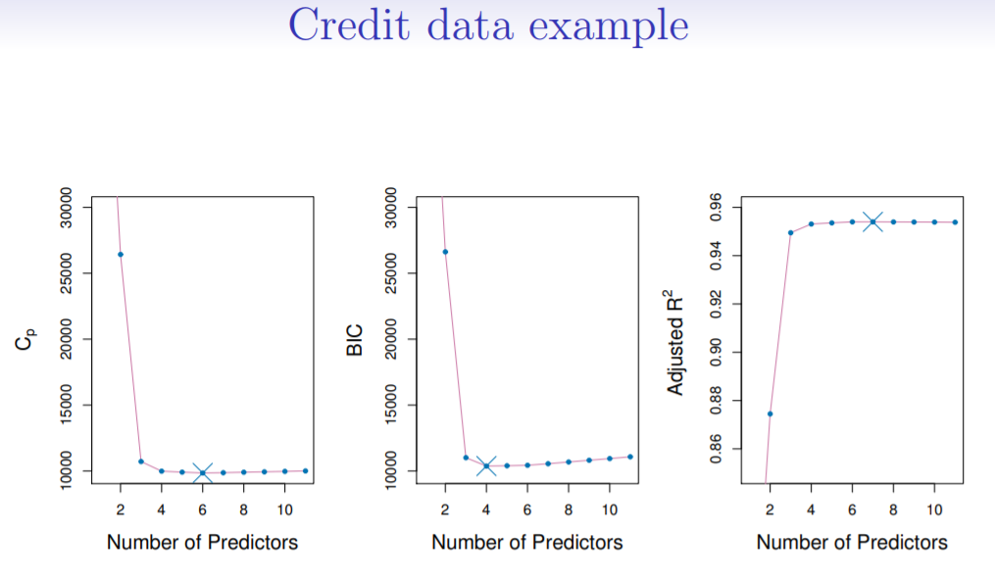
1) Subset Selections – Penalty Metrics
Cp, BIC, Adjusted R2

Slide 16


1) Subset Selections – Penalty Metrics
Mallow’s Cp:
where d is the total # of parameters used and σ^2 is an estimate of the variance of the error associated with each response measurement
AIC criterion is defined for a large class of models fit by maximum likelihood

Slide 17


1) Subset Selections – Penalty Metrics
BIC:
Like Cp, the BIC will tend to take on a small value for a model with a low test error, and so generally we select the model that has the lowest BIC value
Adjusted R^2: Unlike Cp, AIC, and BIC, for which a small value indicates a model with a low-test error, a large value of adjusted R2 indicates a model with a small test error

Slide 18
2) Shrinkage
Ridge and Lasso: Putting a penalty to residual sum squares is the idea behind it
The subset selection methods use least squares to fit a linear model that contains a subset of the predictors.
As an alternative, we can fit a model containing all p predictors using a technique that constrains or regularizes the coefficient estimates, or equivalently, that shrinks the coefficient estimates towards zero
It may not be immediately obvious why such a constraint should improve the fit, but it turns out that shrinking the coefficient estimates can significantly reduce their variance.

Slide 19
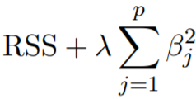
2) Shrinkage
Ridge:
Sums of squares of the coefficients of the variables are put as the penalty
Puts a λ ≥ 0 is a tuning parameter to regularize
The second term is called a shrinkage penalty, is small when β1, . . . , βp are close to zero, and so it has the effect of shrinking the estimates of βj towards zero

Slide 20
2) Shrinkage
Ridge:
Sums of squares of the coefficients of the variables are put as the penalty
Puts a λ ≥ 0 is a tuning parameter to regularize
The second term is called a shrinkage penalty, is small when β1, . . . , βp are close to zero, and so it has the effect of shrinking the estimates of βj towards zero
The tuning parameter λ serves to control the relative impact of these two terms on the regression coefficient estimates
Selecting a good value for λ is critical; cross-validation is used for this

Slide 21
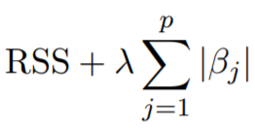
2) Shrinkage
Lasso:
Ridge regression does have one obvious disadvantage: unlike subset selection, which will generally select models that involve just a subset of the variables, ridge regression will include all p predictors in the final model
In statistical parlance, the lasso uses an L1 (pronounced“ell 1”) penalty instead of an L2

Slide 22
2) Shrinkage
Lasso cont.:
As with ridge regression, the lasso shrinks the coefficient estimates towards zero
However, in the case of the lasso, the L1 penalty has the effect of forcing some of the coefficient estimates to be exactly equal to zero when the tuning parameter λ is sufficiently large
Hence, much like best subset selection, the lasso performs variable selection
We say that the lasso yields sparse models — that is, models that involve only a subset of the variables
As in ridge regression, selecting a good value of λ for the lasso is critical; cross-validation is again the method of choice

Slide 23
2) Shrinkage
Lasso vs. Ridge:
Why variable coefficients becomes 0 in Lasso not in Ridge?

Slide 24
2) Shrinkage
Lasso vs. Ridge:
Neither ridge regression nor the lasso will universally dominate the other ( no free lunch )
In general, one might expect the lasso to perform better when the response is a function of only a relatively small number of predictors
Note that optimizing λ is not much a problem practically. It is optimized as other parameters automatically (grid, random searchs)

Slide 25
2) Shrinkage
Elastic-net:
A method to mix both lasso and ridge
It has a parameter that asks you how much should it resemble lasso and ridge
You can arrange 0.8 lasso, 0.2 ridge or 0.4 lasso, 0.6 ridge
The parameter practically set from 0 to 1 and asks how much do we want the model to get from L1 and L2 regularizations

Slide 26
2) Shrinkage - Literature
Ridge: In statistics, a less complex model with the same performance is preferable. Ordinary linear regression does not have an inbuilt method to omit the features which only provide noise if the R-square value is even slightly improved with the contribution of noise variables. Ridge tries to address that problem by adding a penalty to the error term. It is stated in particular, the ridge regression coefficient estimates are the values that minimize RSS + Pp j=1 β 2 j where λ > 0 is a tuning parameter, to be determined separately (James et al., 2013). As with least squares, ridge regression seeks coefficient estimates that fit the data well, by making the RSS small. However, the second term, λ∗ P j β 2 j , is called a shrinkage penalty, is small when β1. . . , βp are close to zero, and so it has the effect of shrinking the estimates of βj towards zero
James, G., Witten, D., Hastie, T., & Tibshirani, R. (2013). An Introduction to Statistical Learning. Springer New York.

Slide 27
2) Shrinkage - Literature
Lasso: Lasso is another method to penalize unnecessary inputs. It is stated that lasso and ridge regression have similar formulations (James et al., 2013). The only difference is that the β 2 j term in the ridge regression penalty has been replaced by |βj | in the lasso penalty. In statistical parlance, the lasso uses an L1 penalty instead of an L2 penalty. λ∗ P j |βj | is the resulting penalty
James, G., Witten, D., Hastie, T., & Tibshirani, R. (2013). An Introduction to Statistical Learning. Springer New York.

Slide 28
2) Shrinkage - Literature
Elastic-net: Elastic net uses a combined penalty of L1 and L2 together. The weights of the L1 and L2 penalties sum to 1 which means they are inversely related. Elastic-net penalty is introduced as a different compromise between ridge and lasso (Zou & Hastie, 2005). Its equation, λ ∗ Pp j=1(α ∗ β 2 j + (1 − α) ∗ |βj |, shows how ridge and lasso are combined with the α term.
Zou, H. & Hastie, T. (2005). Regularization and variable selection via the elastic net. Journal of the Royal Statistical Society: Series B (Statistical Methodology), 67 (2), 301–320

Slide 29
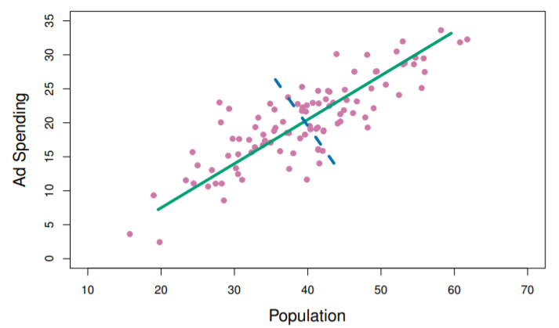
3) Dimentionality Reduction
PCA:
An example: 2 variables (dimentions) are represented as a single dimention

